Slide 3
Intact
Degraded
Mutated in Li- Fraumeni Syndrome
p53
Cell-cycle arrest
Apoptosis
Survival
Replication
Growth
MDM2
p14^{ARF}
Alternatively Spliced Gene Products
CDKN2A
Neoplasia
E1β
E1α
E₂
E₃
25% of familial melanoma kindreds have germline mutations in CDKN2A
p16^{INK4A}
CDK4 is also mutated in familial melanoma
Cell growth
Proliferation
CDK4/6
Growth Arrest
Cyclin D
P
P
Rb
Rb
E2F
DP
Active
Inhibited
Figure adapted from Bolognia, Jean., Jorizzo, Joseph L.Schaffer, Julie V. (Eds.) (2012) Dermatology
E2F
DP
Notes:
Transcripts utilizing the E1a exon produce p16INK4A, which inhibits CDK4/6, and those with the E1b element transcribe the MDM2- inhibitor p14ARF

Slide 5

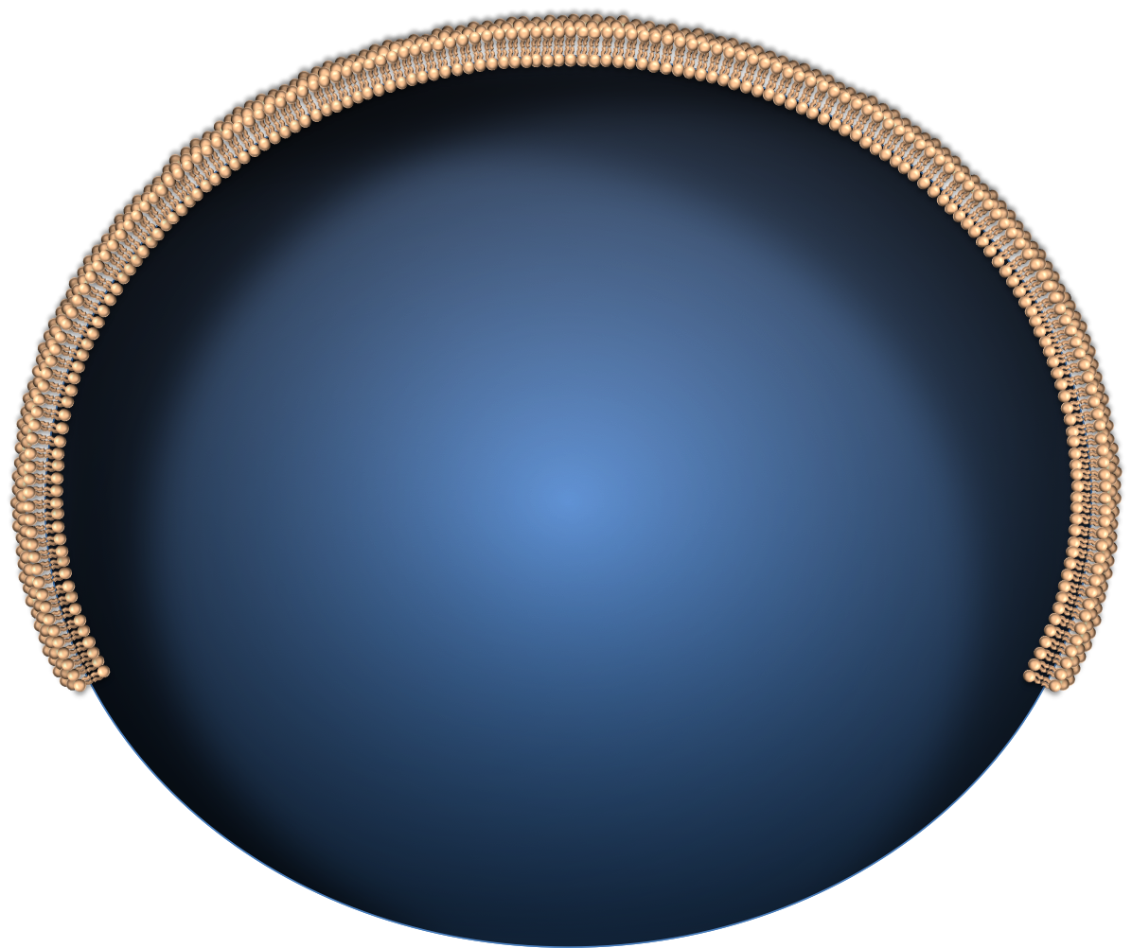
c-KIT
Shc
Grb
RAS
ARF
SOS
UV Radiation
MDM2
BRAFV600E
ATR
ATR
ATM
MEK
p53
CHK2
ATM
ERK
p21
JNK
P16^{INK4A}
CDK4/6
CDK4/6
Cyclin D
DNA Damage
Rb
Jun
c-Fos
Cell Proliferation
E2f
Rb
Telomere Attrition
Hyper-Replicative DNA
E2f
Transcription
SAHF
Notes:
Although more than 40 different mutations in BRAF have been described,3 the most clinically relevant mutation is the BRAFT1799A, which results in the substitution of valine by glutamic acid (V600E) in the kinase domain of the protein. 90% of the clinically relevant mutations are V600E; 10% are V600K, where valine is changed to lysine

